Slide 1



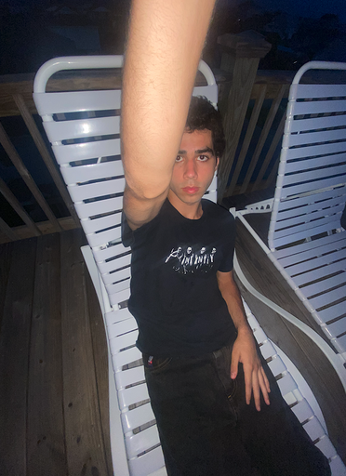

GAME CORNER
Javarris Barnett
Katelyn Bunker
Khaoula Jabour
Lane Byers
Robert Field

Slide 2

ELEVATOR PITCH - Javarris
Are you a board game fanatic?
This is the right place to keep track of your collection of games! Sign up to start building your list of favorite games that you want to play again, games that you hate and never want to see, or games that you want to buy and play.

Slide 3

USER CONCEPT - katelyn
As a board game fanatic // I would like a place to keep track of my collection of games I've played // so that I can remember what games I've loved and hated

Slide 4
PROCESS - khaoula
Breakdown of tasks and roles
Javarris Barnett – Server side and backend functionality
Katelyn Bunker – API Calls and Models
Khaoula Jabour – Login and signup
Lane Byers – Dashboard
Robert Field – PowerPoint, README, API Support

Slide 5
PROCESS - khaoula
Technologies used
API calls and models with JavaScript
Express
Bcrypt
Sequelize
Board Game Atlas
New Technology?
Node Fetch

Slide 6
PROCESS - robert
Challenges
GitHub pushes and pulls
Links between several files with multiple contributors
Assignment(s) and Project
Successes
Full Stack
Team Communication
Slack
Zoom

Slide 7
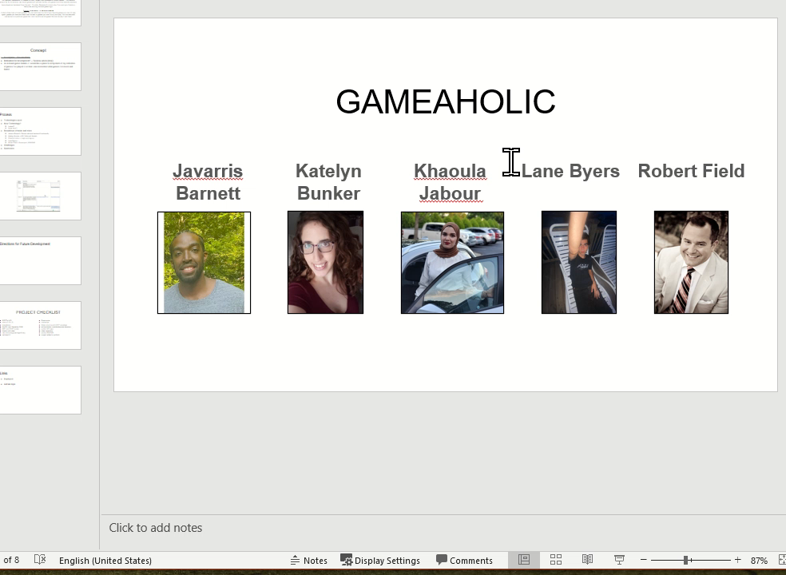
Demo - team

Slide 8
FUTURE DEVELOPMENT - lane
Hovering over game image, user comments scroll
Chat
Delete lists and games
Top contributor lists and reviews
Developer section
Link to site(s) that sells games like Amazon
OAuth 2.0 (access tokens)

Slide 9
PROJECT CHECKLIST
RESTful API
C.R.U.D
Handlebars
MySQL and Sequelize ORM
GET and POST routes
Heroku with data
New technology/package/library
Polished UI
Responsive
Interactive
Folder structure with MVC paradigm
Authentication
Protect API keys
Clean repository
Quality README
Project added to portfolio

Slide 10
LINKS
Deployed
Link
GitHub repo
GitHub Repo

